Slide 1
Programming For Data Science Course SQL Project
PREPARED BY:
Shady Abdallah
August, 31st 2018

Slide 2
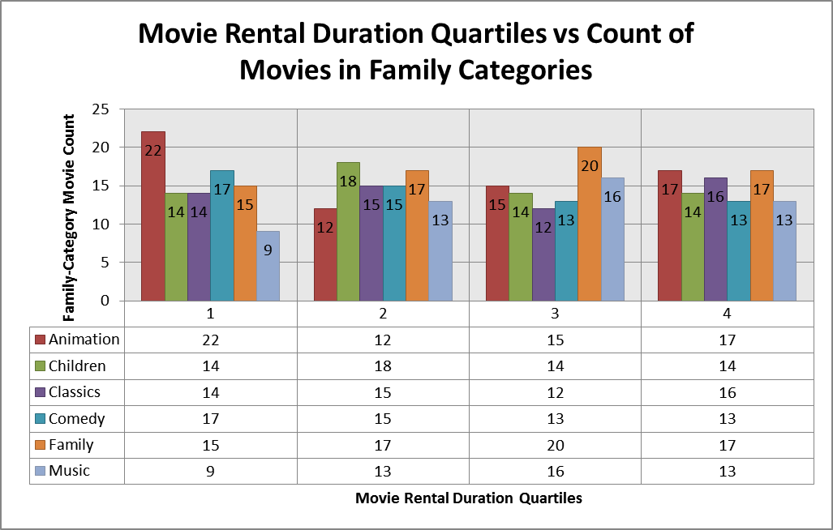
Question #1 (Question 3 from Set 1) SQL Project
Q: Provide a table with the family-friendly film categories (Animation, Children, Classics, Comedy, Family and Music), each of the quartiles (movie titles divided into 4 levels based on movie rental duration), and the corresponding count of movies within each combination of film category for each corresponding rental duration category.
The results show that for the Fourth Quartile (the movies with highest rental durations) movie count is almost matching in all family categories.
For the first Quartile (lowest rental durations), however, Animation movies count is the highest.

Slide 3
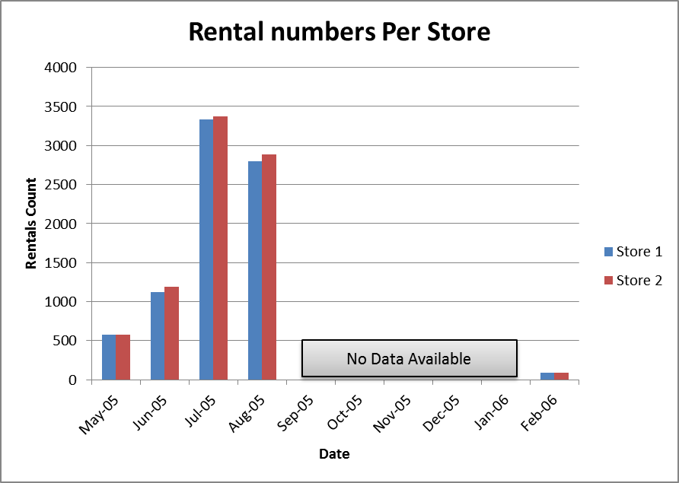
Question #2 (Question 1 from Set 2) SQL Project
Q: We want to find out how the two stores compare in their count of rental orders during every month for all the years we have data for. Write a query that returns the store ID for the store, the year and month and the number of rental orders each store has fulfilled for that month. Your table should include a column for each of the following: year, month, store ID and count of rental orders fulfilled during that month.
The results show that both stores have closely matching rental orders per month, but on average, however, store 2 slightly exceeds store 1.
No data is available from the end of August ‘05 to end of January ‘06.

Slide 4
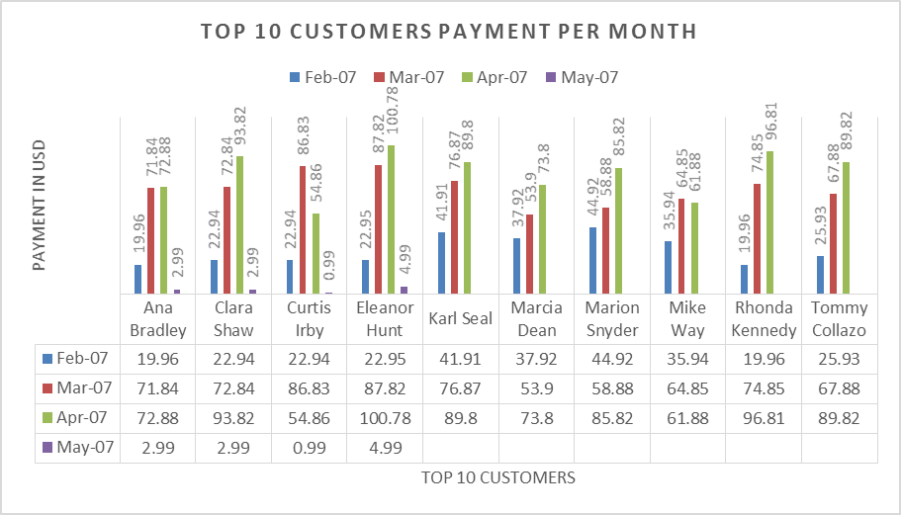
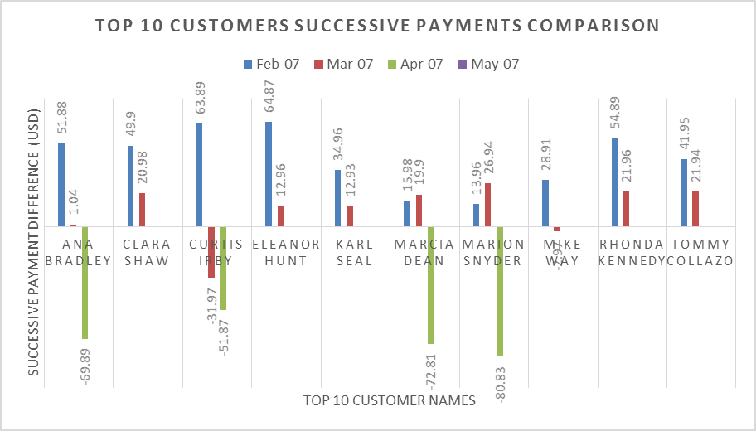
Question #3 (Question 1 from Set 2) SQL Project
Q: For each of the top 10 paying customers, we would like to find out the difference across their monthly payments during 2007. Please go ahead and write a query to compare the payment amounts in each successive month. Repeat this for each of these 10 paying customers. Also, it will be tremendously helpful if you can identify the customer name who paid the most difference in terms of payments.
A: Top 10 Customers successive payment data comparison has shown that Eleanor Hunt has got the maximum difference of 64.87 USD during March 2007 from 22.95 USD in February 2007.

Slide 5
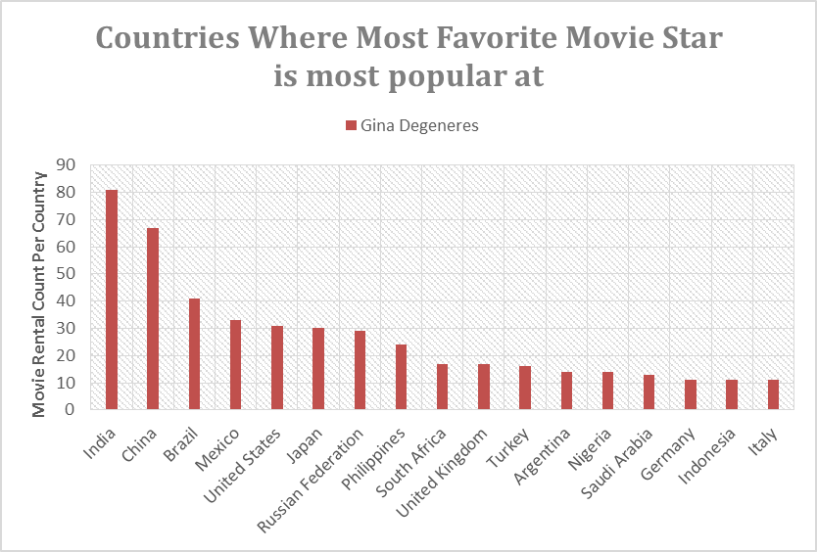
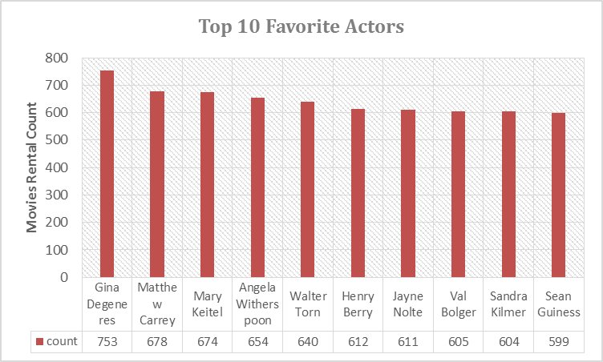
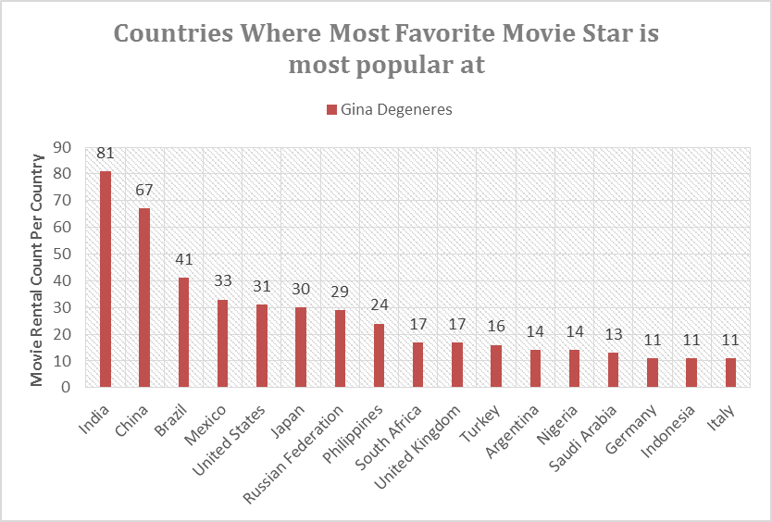
Question #4 SQL Project
Q: We want to know who is the customers favorite movie star based on number of rentals of movies they starred in, and then find out which country that movie star is most popular at.
A: Gina Degeneres is the customers’ favorite movie star based on a value of 753 movie rental count in total, and she is most popular in India with 81 rentals of movies she starred at.

